Slide 1
Symmetric Matrices and Quadratic Forms
6.3 Constrained Optimization
Bumhee Cho

Slide 2

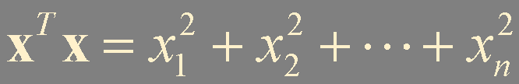
maximum
minimum
constraint
= 1
Notes:
quadratic form의 최대 최소값이 궁금할 수 있음.
우리가 다룰건 전영역에서의 최대 최소값이 아니고,
어떤 구속 조건하에서의 최대 최소 값을 살펴보고자 함.

Slide 3
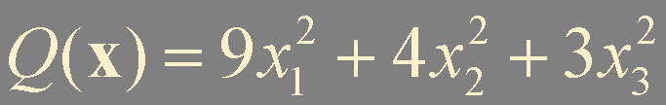

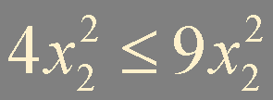
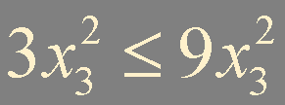
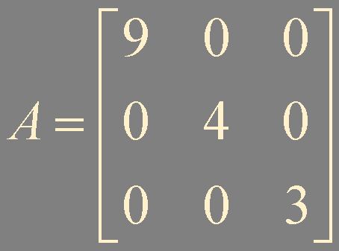
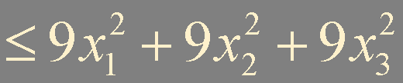
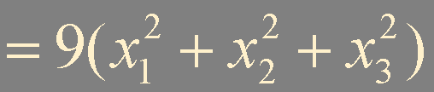
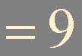
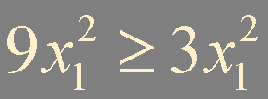
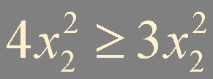


?
!
Find the maximum and minimum values of
subjected to the constraint x^{T}x = 1
Example 1
maximum
λ = 9
x = (1, 0, 0)
x = (-1, 0, 0)
minimum
λ = 3
x = (0, 0, 1)
x = (0, 0, -1)
λ
9, 4, 3

Slide 4
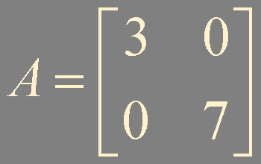
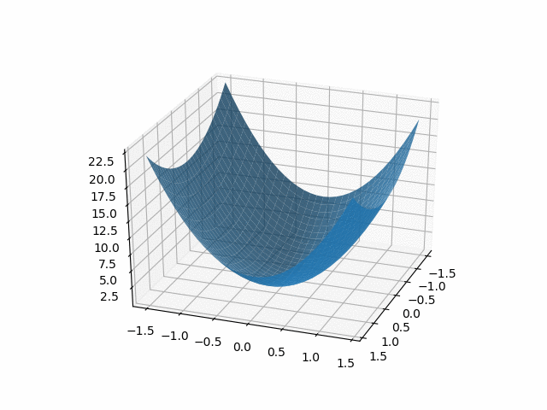
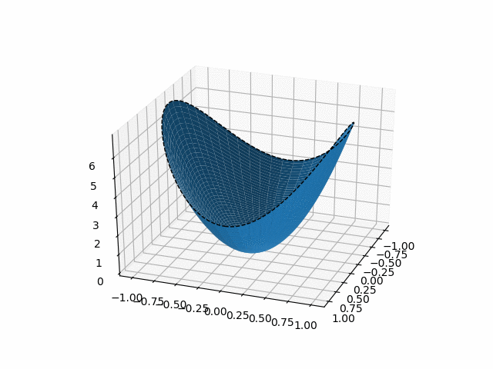
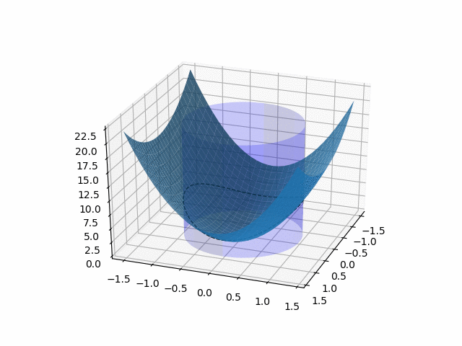
maximum = 7
x^{T}x = 1
Q(x) = x^{T}Ax
minimum = 3
x₁ x₂ z
Q(x)
Q(x)
x^{T}x = 1

Slide 5
m = min {x^{T}Ax: ||x|| = 1}
M = max {x^{T}Ax: ||x|| = 1}
Theorem 6.
Let A be a symmetric matrix.
M is the greatest eigenvalue λ₁ of A and m is the least eigenvalue of A.
The value of x^{T}Ax is M when x is a unit eigenvector u₁ corresponding to M.
The value of x^{T}Ax is m when x is a unit eigenvector corresponding to m.

Slide 6
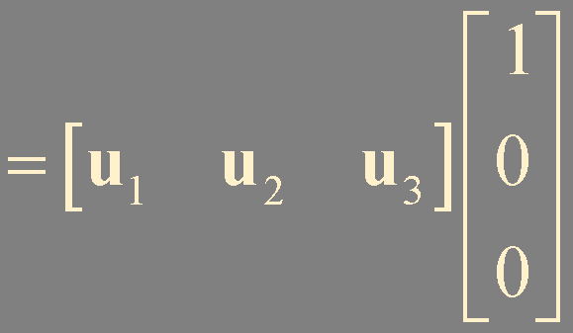
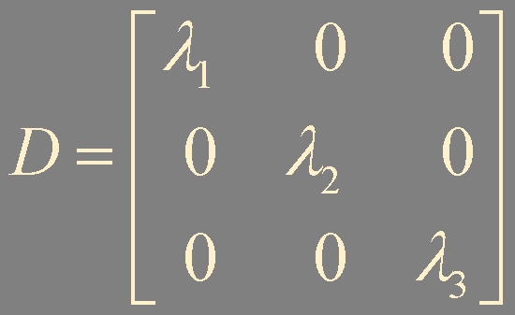
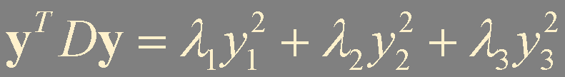
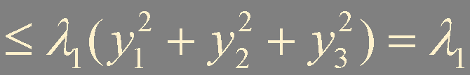
A is a symmetric matrix
orthogonally diagonalizable
x^{T}Ax
= y^{T}Dy
x = Py
||x|| = ||Py||
= ||y||
x = Pe₁
||Py||²
= y^{T}P^{T}Py
= y^{T}y
= ||y||²
||x|| = 1 if and only if ||y|| = 1
= u₁
λ₁ ≥ λ₂ ≥ λ₃
P = [ u₁ u₂ u₃ ]
M ≤ λ₁
y = e₁= (1, 0, 0)
M = λ₁

Slide 7

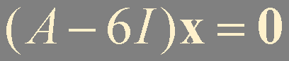

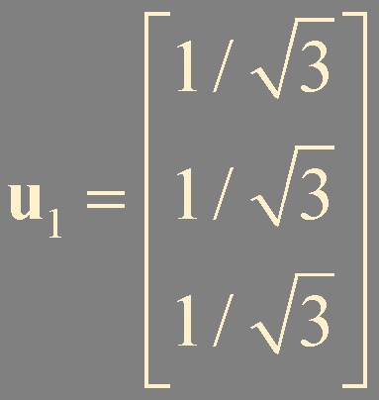
?
!
Let A = . Find the maximum value of the quadratic
form x^{T}Ax subject to the constraint x^{T}x = 1, and find a unit vector at which this maximum value is attained.
Example 2
Find a normal eigenvector corresponding to λ = 6
-u₁

Slide 8
Theorem 7.
Let A, λ₁, and u₁ be as in Theorem 6. Then the maximum value of x^{T}Ax subject to the constraints
x^{T}x = 1, x^{T}u₁ = 0
is the second greatest eigenvalue, λ₂, and this maximum is attained when x is an eigenvector u₂ corresponding to λ₂.
λ₁ > λ₂ ≥ λ₃
P = [ u₁ u₂ u₃ ]
y = e₂= (0, 1, 0)

Slide 9
Theorem 8.
Let A be a symmetric n × n matrix with an orthogonal diagonalization A = PDP⁻¹, where the entries on the diagonal of D are arranged so that λ₁ ≥ λ₂ ≥ ⋯ ≥ λ_{n} and where the columns of P are corresponding unit eigenvectors u₁,… , u_{n}. Then for k = 2,…, n, the maximum value of x^{T}Ax subject to the constraints
x^{T}x = 1, x^{T}u₁ = 0, … , x^{T}u_{k-1} = 0
is the eigenvalue, λ_{k}, and this maximum is attained at
x = u_{k}.

Slide 10
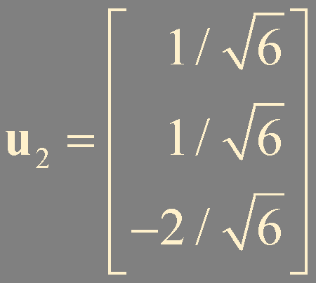
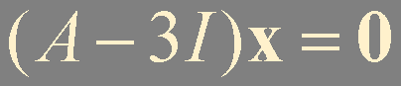
!
?
Let A = . Find the maximum value of the quadratic
form x^{T}Ax subject to the constraint x^{T}x = 1 and x^{T}u₁ = 0 where u₁ is a unit eigenvector corresponding to the greatest eigenvalue of A, and find a unit vector at which this maximum value is attained.
Example 3
Find a normal eigenvector corresponding to λ = 3
-u₂

Slide 11
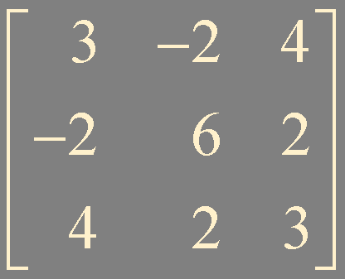
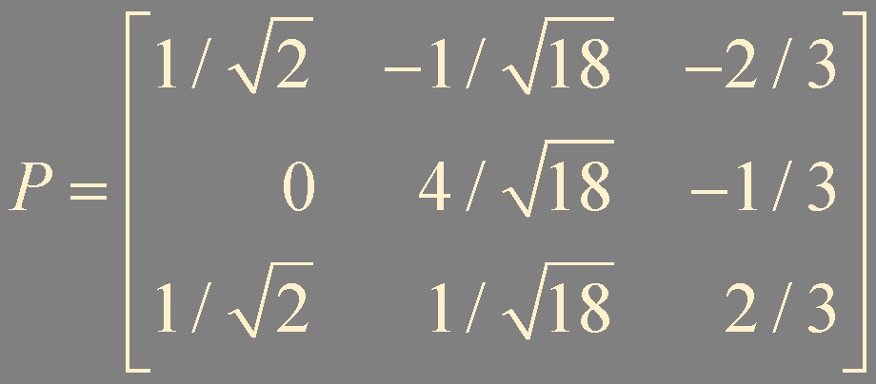
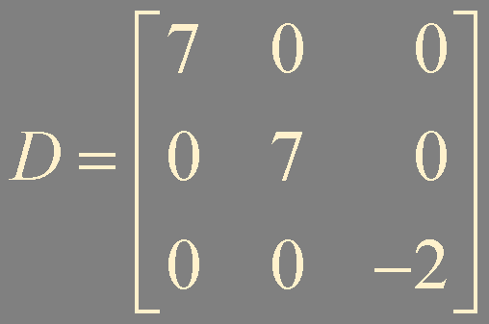
?
!
Let A = . Find the maximum value of the quadratic
form x^{T}Ax subject to the constraint x^{T}x = 1, and find a unit vector at which this maximum value is attained.
Example 4
u₁
u₂
λ = 7 with multiplicity = 2
eigenspace for λ = 7
v = αu₁ + βu₂
v^{T}Av
= v^{T}(λ₁αu₁ +λ₂βu₂)
Span {u₁, u₂}
α² + β² = 1
= λ₁v^{T}(αu₁ +βu₂)
a unit vector
in Span {u₁, u₂}
||v||² = α²||u₁||² + β²||u₂||² = 1
= λ₁v^{T}v = λ₁ = 7

Slide 12
Summary
Constrained optimization

